Slide 1
Introduction to Integrated Assessment Modeling

Slide 2
Bio – Haewon McJeon, PhD
B.A. in Economics at Seoul National University
Ph.D. in Environmental Policy at University of Maryland
Senior Economist at PNNL (on leave)
Faculty Affiliate with UMD (on leave)
Visiting Professor at KAIST (new)
Modeling Support for the Paris/Glasgow Agreement negotiations
IAM modeling lead for the U.S. Long-Term Strategy
IAM modeling lead for the America’s Pledge/All-In Reports
Lots of modeling…
Low Carbon – Shale Gas
Zero Carbon – Solar Wind
Negative Carbon – BECCS DACCS
Notes:
SNU: Seoul National University
UMD: University of Maryland

Slide 3
Self-Introductions

Slide 4
Agenda
1:30 – 2:45 Section I
What are IAMs
What IAMs do (and what they don’t)
Why do we need them
2:45 – 3:00 Break
3:00 – 4:00 Section II
Course logistics
Downloading & installing GCAM

Slide 5

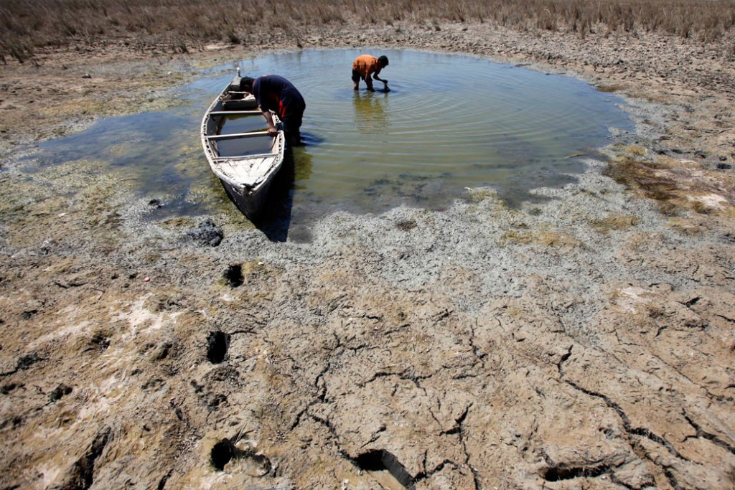
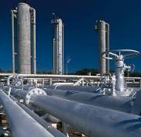


Society has multiple interconnected goals and challenges
Increased food production is required to feed a world of 8 billion by 2030, 9 billion by 2050
Increased dependence on food trade exposes countries to water stress impacts abroad
Food security
Irrigation for crops creates scarcity and competition among water users (e.g., agriculture and energy), unsustainable groundwater depletion, and ecosystem impacts
Climate change is worsening flood, drought, and asset (e.g., power plant) risks
Water security
Cheap, carbon-intensive energy sources may support short-term energy security in some regions, but this contributes to long-term climate change, poor air quality, and cooling water demands
Trade-offs between water and energy requires complex, integrated management
Energy security
Climate change affects human health for example, by increasing airborne allergens that cause asthma
Consumption of fossil fuels also release local air pollutant emissions that harm human health
Air quality and human health
Humans are warming the planet by producing energy and land use change emissions
This creates steep risks for ecosystems (e.g., via drought) and human infrastructure (e.g., via floods, wildfires, hurricanes, sea level rise, etc.) that affect our ability to produce food and power
Climate change

Slide 6
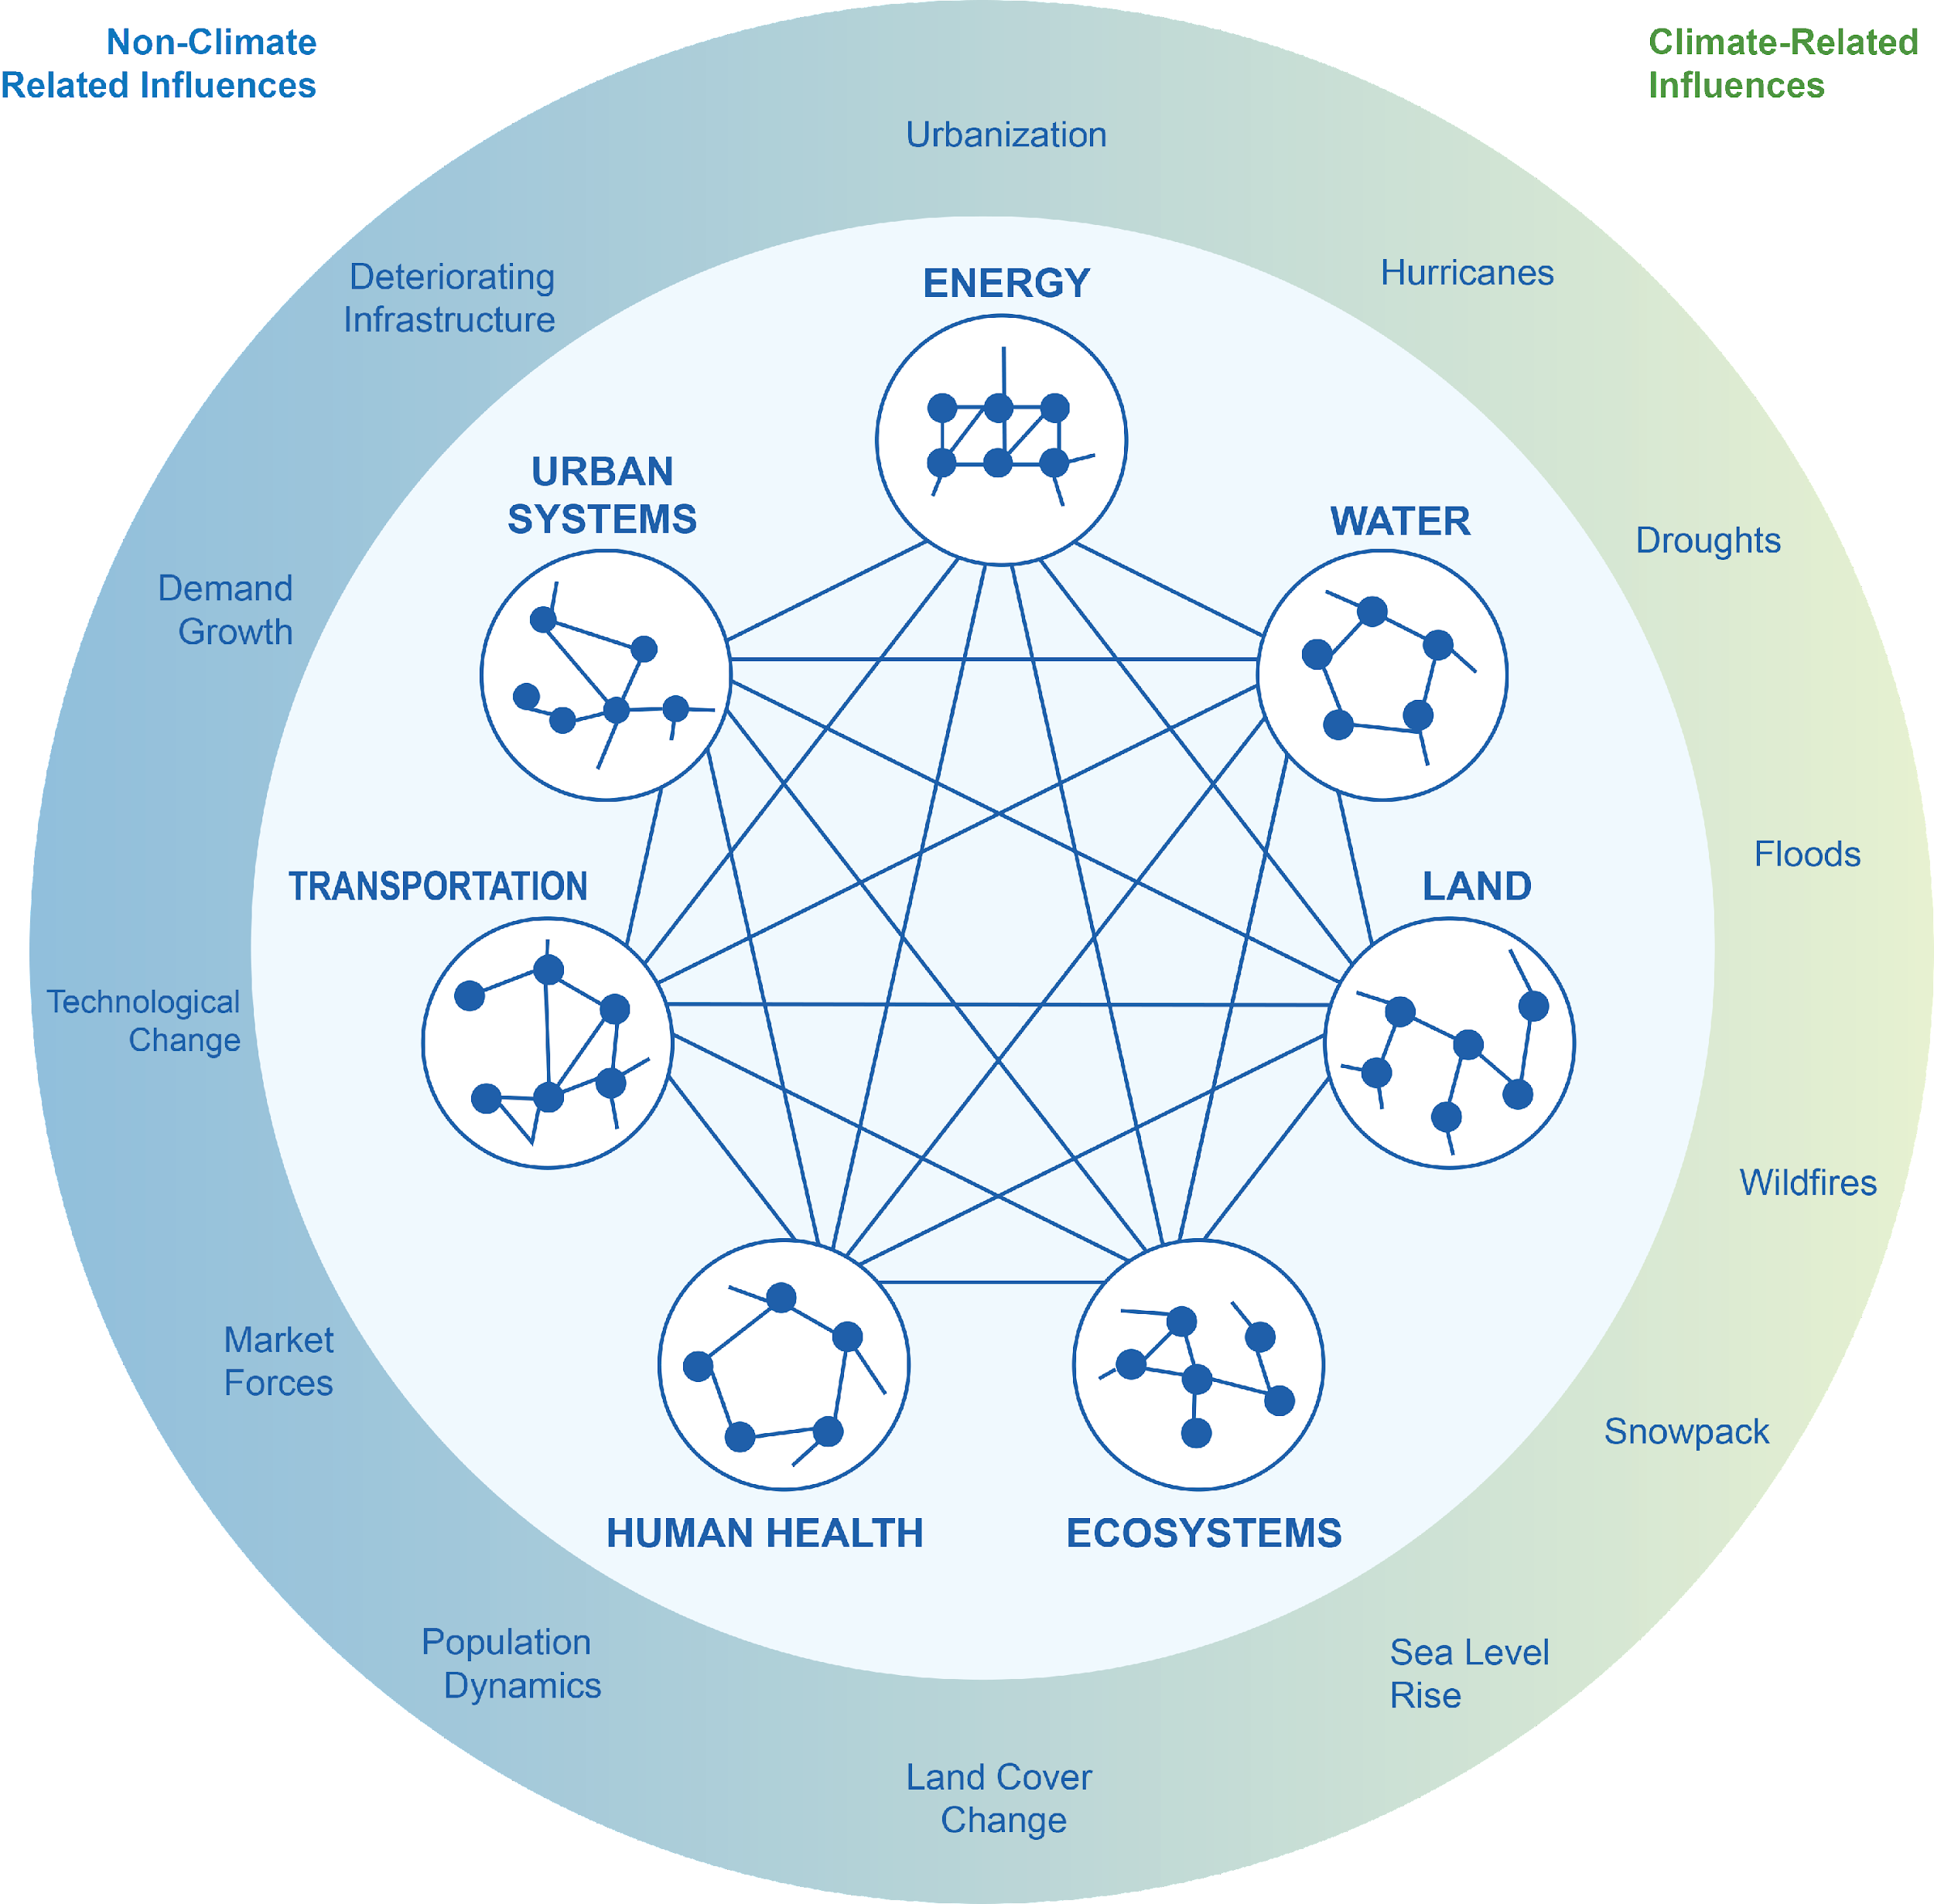
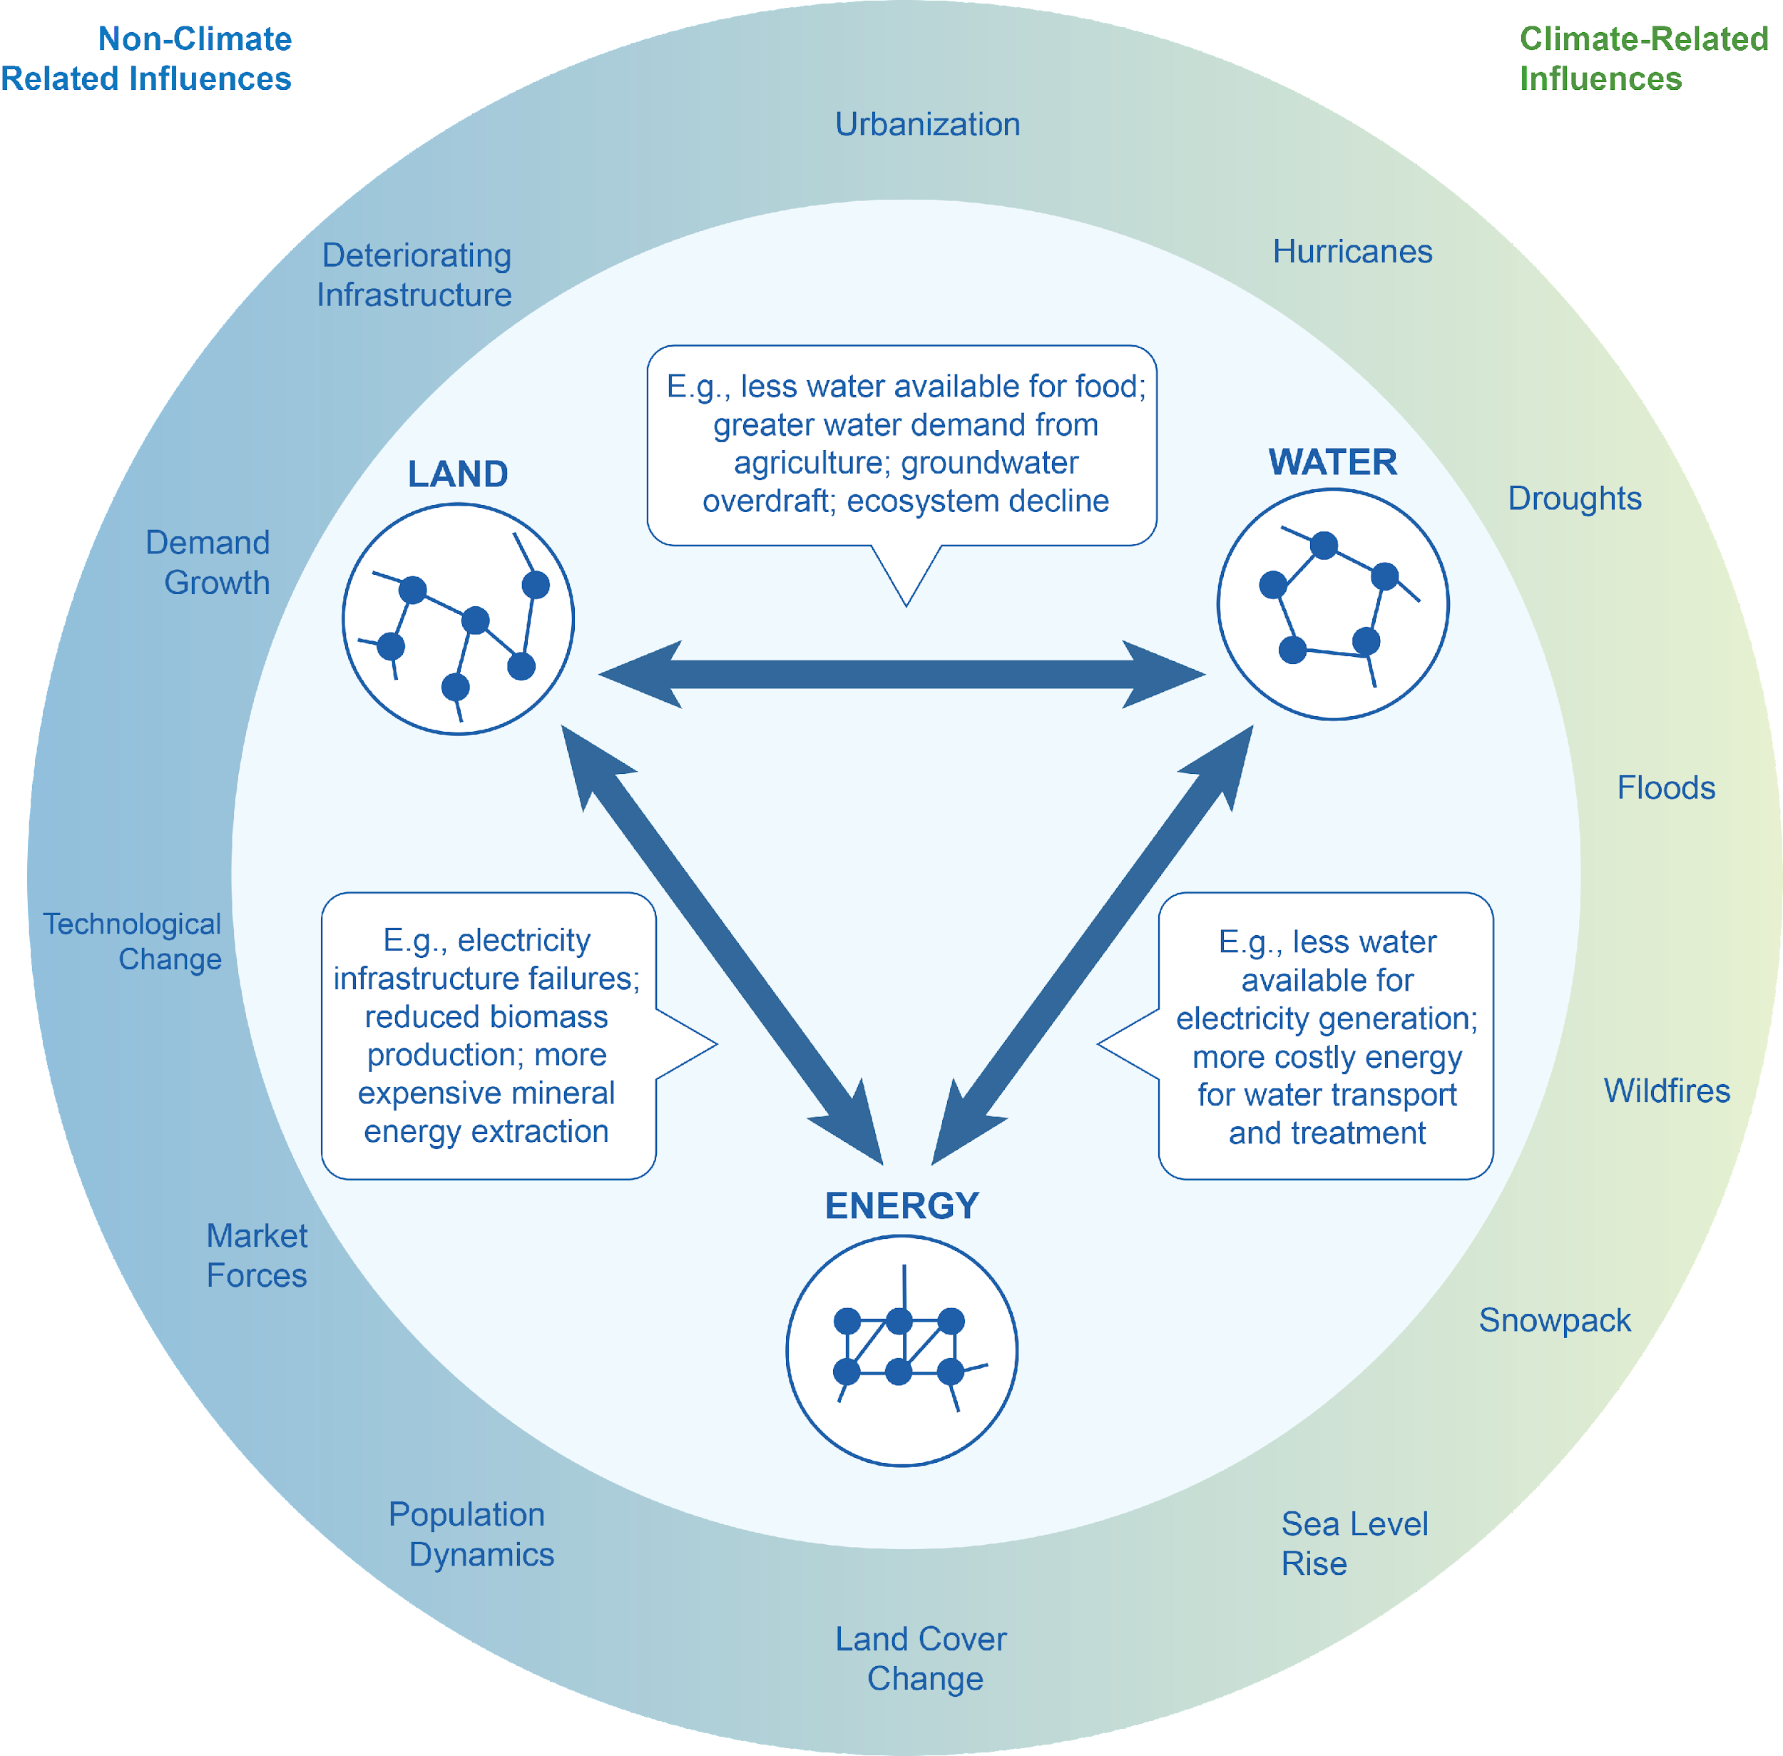
Coupled Human-Earth Systems
The world we live in is a complex web of natural, built, and social systems (i.e., coupled human-earth systems)
Energy, water, land and other system elements are highly interconnected
Multiple climate and non-climate factors influence the way these systems behave and interact with one another
Notes:
Figure Source: Clarke et al. (2018), Fourth National Climate Assessment (https://nca2018.globalchange.gov/chapter/17/)

Slide 7
Some Examples of Complex Sectoral Interactions
Population grows, demanding more energy, land for food, and water for the food and energy
Humans produce more emissions, which alter climate, resulting in altered water availability and increasing energy system requirements
Tensions across water users (agriculture and energy) occur, requiring coordinated planning
Relevant Lectures
Feb 8 | Energy System (Dr. Gokul Iyer)
Feb 15 | Agriculture and Land System (Dr. Xin Zhao)
Feb 22 | Water System (Dr. Neal Graham)
Mar 1 | Food-Energy-Water Nexus (Dr. Tom Wild)
Notes:
Here on this slide we just focus on a subset—Energy, Water, and Land--which will actually be a key focus in terms of the modules we present in this class.

Slide 8
What are the “big questions” being asked today?
“What if” questions:
What would happen to the climate if society takes different development pathways?
What would happen to food, energy, water, and health if future climate is altered?
What would happen to land and water if we employ a large amount of negative emission technologies in the energy system like biomass and carbon capture and storage (BECCS)?
“How to” questions:
How do we achieve the emissions reductions required to hit a temperature target that acceptably limits climate change?
How can we mitigate climate change while still achieving other societal goals?
How can we assess our confidence in these predictions?
Feb 1 | Foundations of IAM (Prof. Jae Edmonds)
Mar 15 | Standardized Scenarios (Dr. Brian O’Neill)
Mar 1 | Food-Energy-Water Nexus (Dr. Tom Wild)
Mar 8 | IAM in International Climate Policies (Prof. Nate Hultman)
Apr 5 | IAM in National Strategies
Apr 12 | Mitigation and other SDGs (Prof. Christoph Bertram)
Mar 29 | Multi-model Comparison (Prof. Leon Clarke)
Apr 19 | Uncertainty in IAM and Climate Change (Dr. Steve Smith)
Notes:
IAMs began in the early years answering what-if questions, like confirming what’s going to happen with warming if humans continue on their current socioeconomic development trajectory.
And then they moved to how-to questions—like what do we do about it.
As IAMs have moved into the how-to space, the societal implications have become stronger, and the modeling has become extremely visible/public-facing and facing scrutiny.

Slide 9
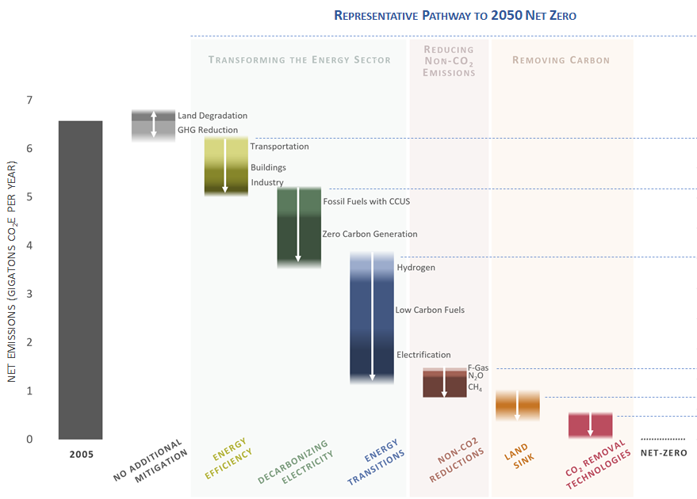
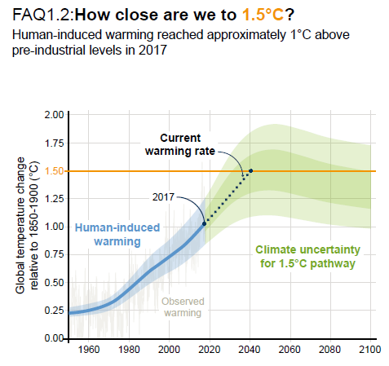
Integrated Assessment Models are Designed to Answer These Questions
How do we achieve the emissions reductions (nationally and/or globally) required to hit a temperature target that acceptably limits climate change?
“How to”
“What if”

Slide 10
Discussion questions
Have you heard of IAMs? What are they?
How are IAMs different from other modeling tools?
What do you expect to learn from this course?
Notes:
Haewon start

Slide 11
What are Integrated Assessment Models (IAMs)?
The keywords:
Global
Natural systems
Integrated human-Earth systems
Long-term
Climate change
Human systems
Scenarios
GHG emissions
Multi-system multi-sector interlinkages

Slide 12
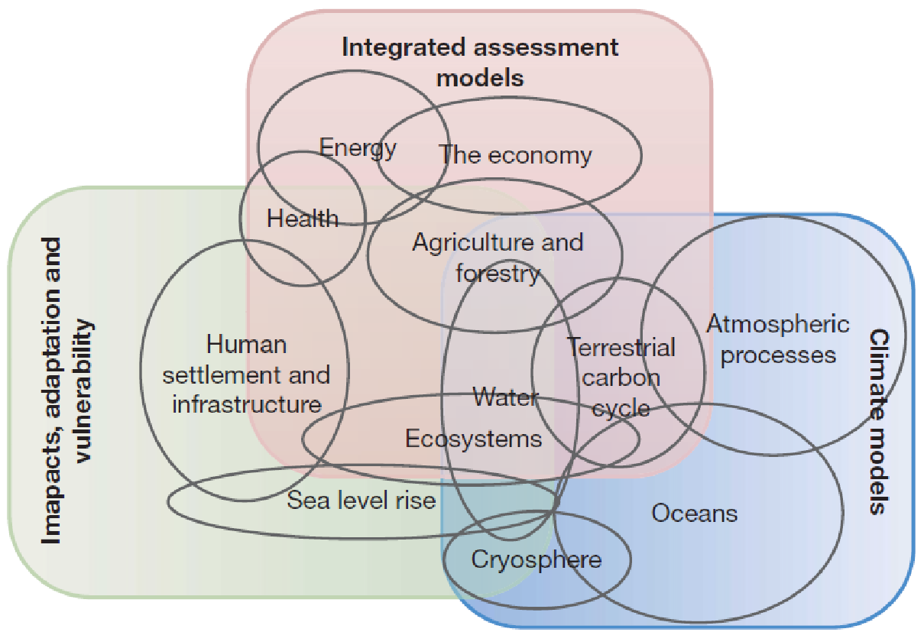
IAMs are just one of several different kinds of models used to study climate change

Slide 13
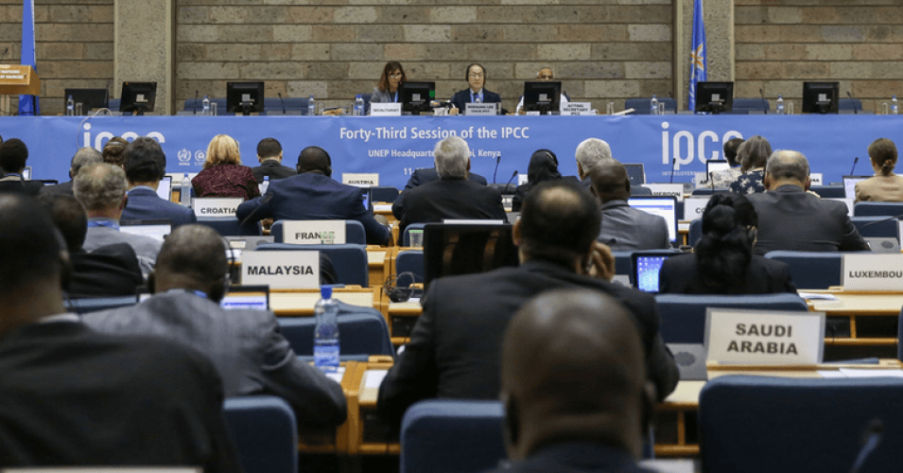

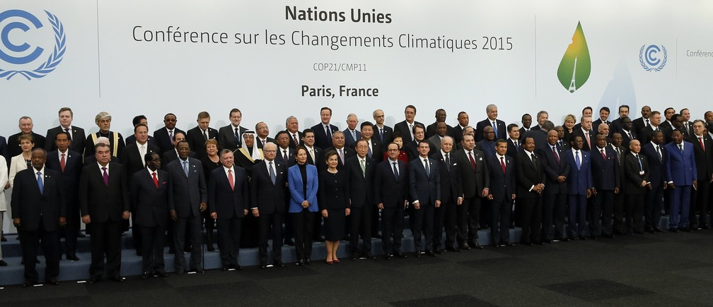
What are Integrated Assessment Models (IAMs)?
IAMs explore how human development and societal choices interact with and affect the natural world (e.g., climate change).
They integrate representations of both human and earth systems.
They have been used to (1) understand and assess the magnitude of human-induced global warming, and (2) support the identification of possible solutions and the tradeoffs they create
Science and knowledge (e.g., IPCC)
National policies
International agreements

Slide 14
Two Broad Categories of IAMs
Our focus in this course
“Simple” IAMs
(e.g., DICE, PAGE, FUND)
“Complex” IAMs:
(e.g., MESSAGE (IIASA, Austria), IMAGE (PBL, Netherland), AIM (NIES, Japan), GCAM (PNNL, USA), REMIND (PIK, Germany), WITCH (CMCC, Italy)
Small number of simple equations
Focused on climate policy benefit-cost analysis (benefits=avoided damages)
Can quickly identify the most important drivers of benefits/costs of climate policy
Lightweight, can quickly incorporate new findings and assumptions
Thousands of complex equations describing physics, chemistry, biology, economics
Explore the details of mitigation pathways--energy/land sector transformations, alternative market instruments, implications of regional delays and non-cooperation
Exploring multi-system (i.e.) feedbacks between human and climate system is possible (currently cutting-edge)

Slide 15
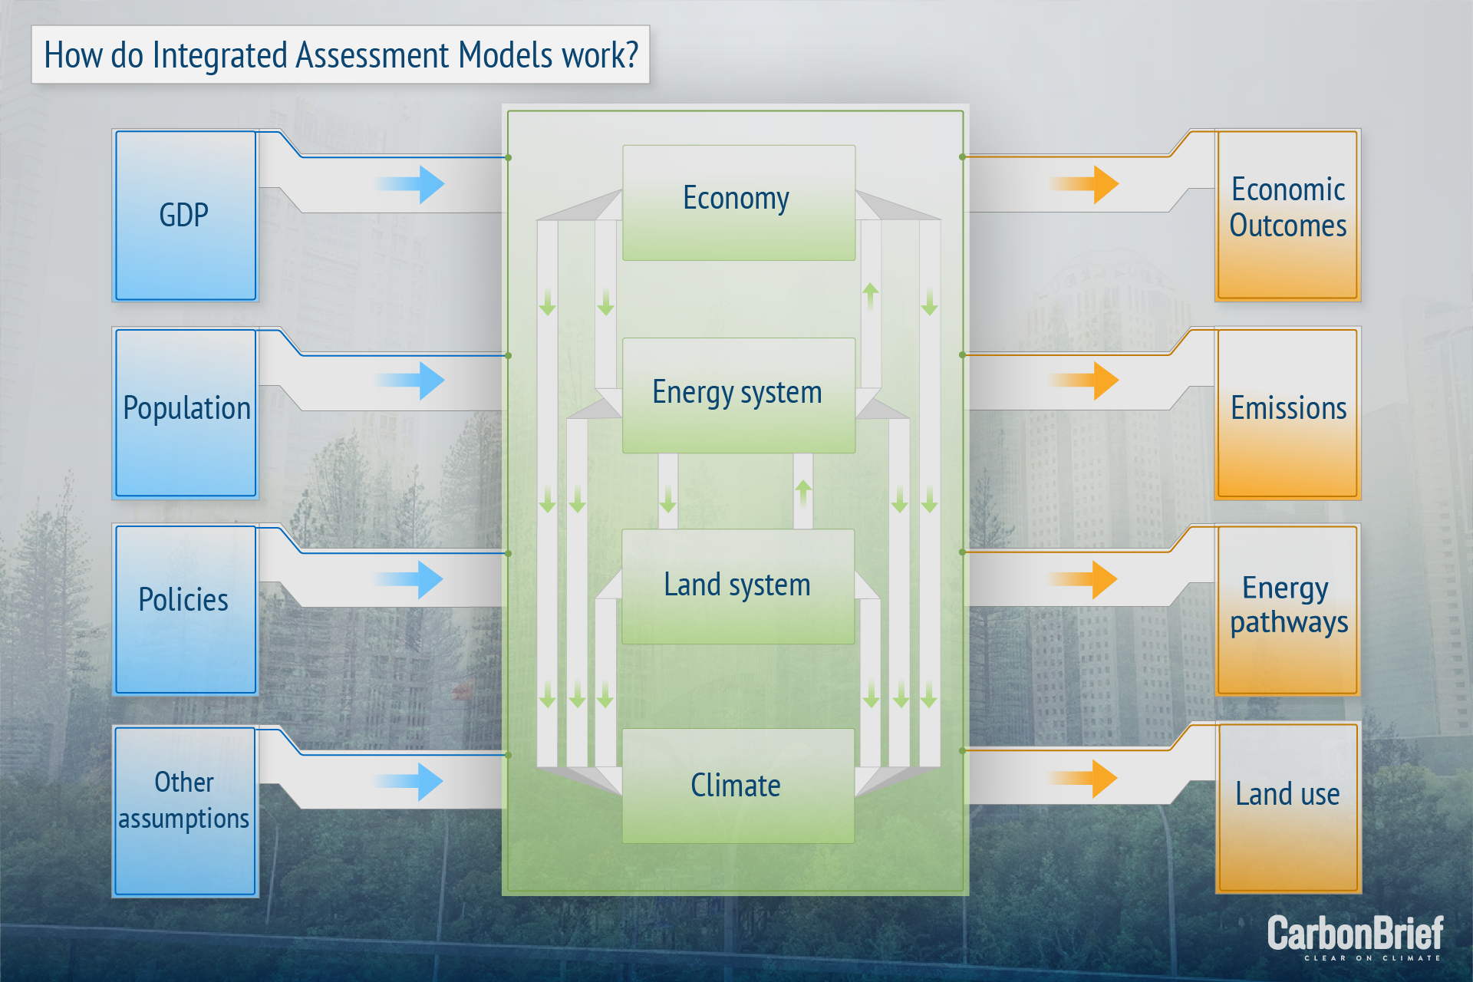

Slide 16
What information do IAMs read in and what do they produce
Water
Inputs
Outputs
Energy
Energy supply and energy prices
Economy
Climate
Technology efficiency and costs
Land
Impact on emissions
Impact on climate
Population and GDP pathways
Energy demand
Food demand
Water demand
Emissions factors
Land productivity and costs
Agriculture production, land use and food prices
Both inputs and outputs are quantitative.
Qualitative storyline -> quantitative inputs
Quantitative outputs -> qualitative insights

Slide 17
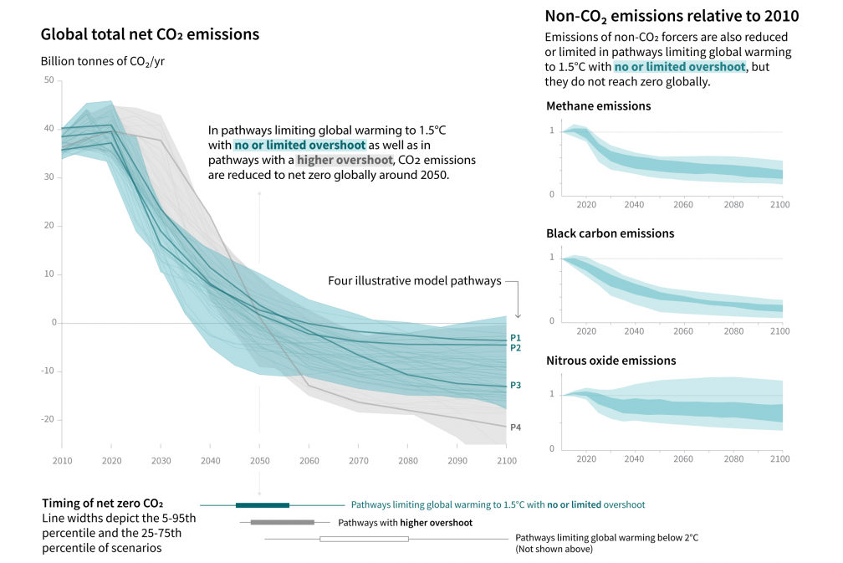
Classic IAM outputs: emissions pathways
CO2 emissions pathways
Non-CO2 emissions pathways

Slide 18
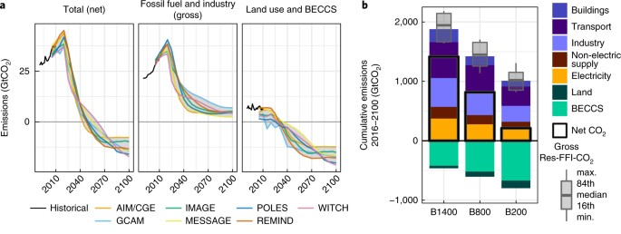
Classic IAM outputs: emissions pathways
Sectoral details of the emissions pathways
Cumulative CO2 or carbon budget
Global and sectoral emissions in 1.5–2°C pathways
Luderer et al. 2018. NCC

Slide 19
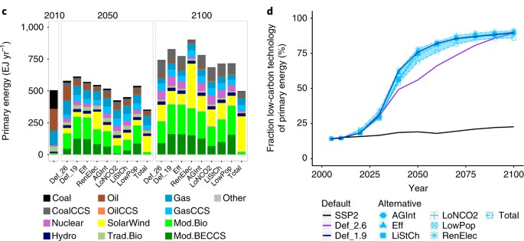
Classic IAM outputs: energy system transformation
Energy supply
Primary energy by different fuels and technologies
Share of low-carbon technologies is consistent across alternate scenarios
van Vuuren et al. 2018. NCC
Notes:
Krey paper chart

Slide 20
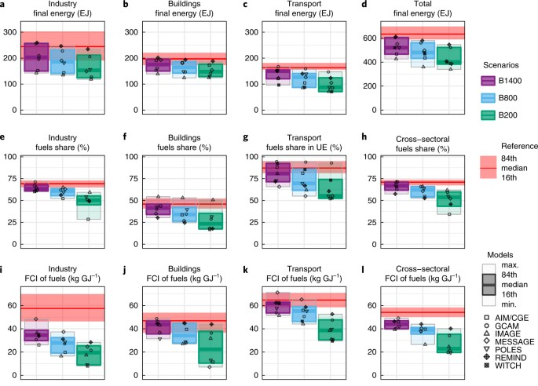
Classic IAM outputs: energy system transformation
End-use sectors
Total energy consumption
Non-electrification
Fuel carbon intensity
Luderer et al. 2018. NCC
Notes:
Krey paper chart

Slide 21
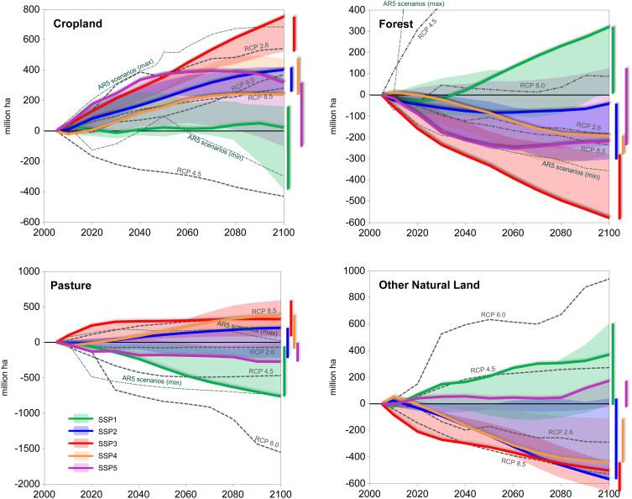
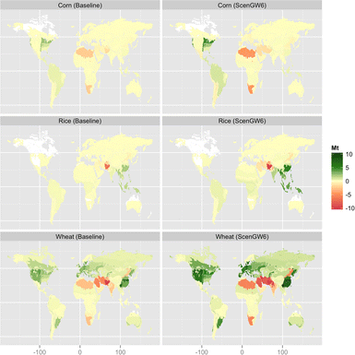
Classic IAM outputs: land use change
Agriculture system: food and non-food demand, production, trade, price
Changes in crop productions in million tons (Mt) for corn, rice, and wheat in 2100 between the water unconstrained and constrained cases
Kim et al. 2016. Climatic Change
Popp et al. 2017

Slide 22
Discussion questions
What’s your understanding of IAM and IAM analysis?
How are IAMs different from other modeling tools?
What do you expect to learn from this course?

Slide 23
What IAMs do (and what they don’t)
Produce insights that are either robust or sensitive to future uncertainties
Explore long-term dynamics (decades or centuries)
Focus on interactions among sectors/systems
Assess how human behaviors impact on the climate
Explain history, produce forecasts, or make policy decisions
Capture short-term variability
Represent high-resolution details of a specific sector
Measure economic impacts due to climate change (forthcoming)

Slide 24
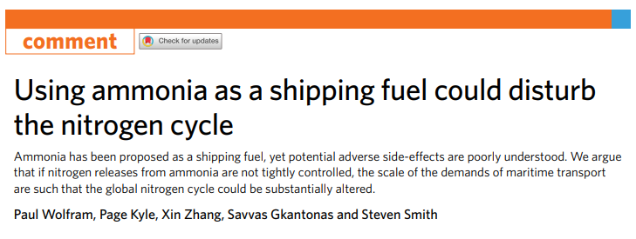
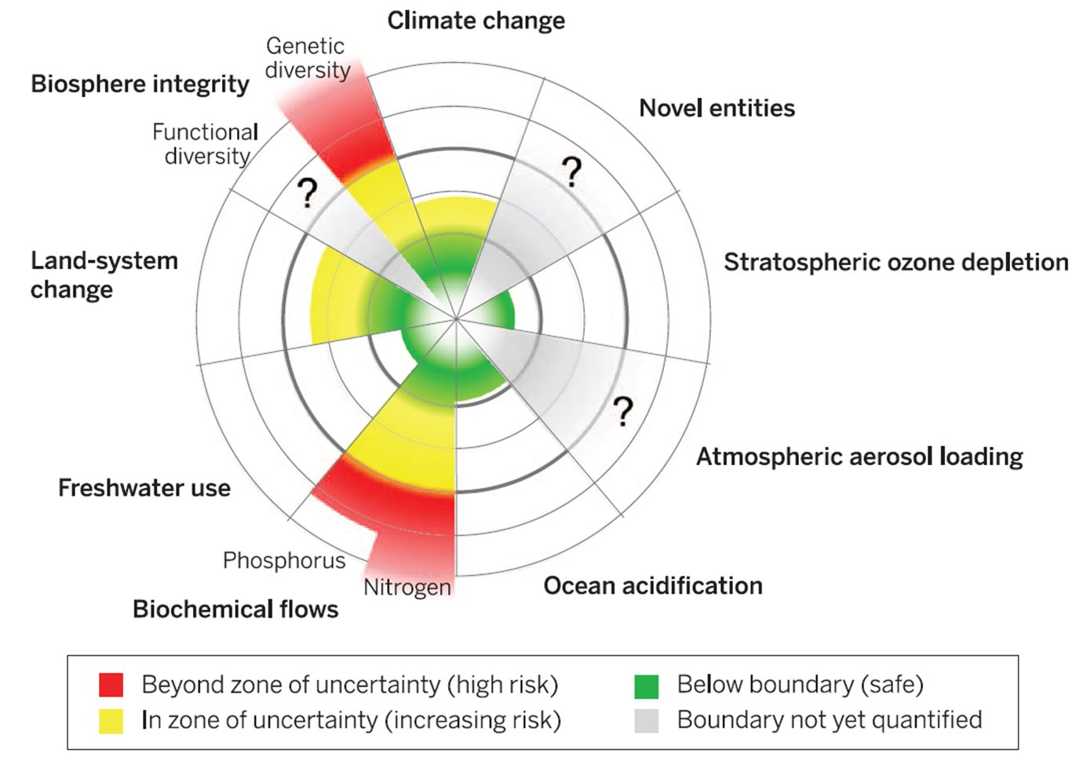
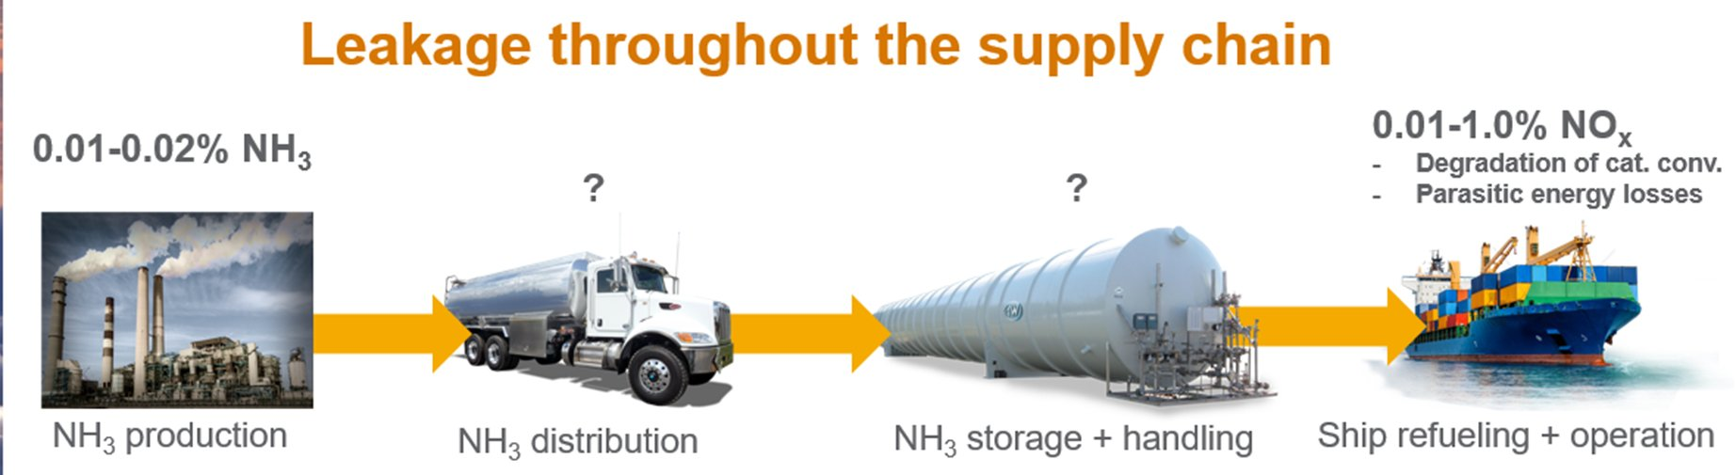
Detailed sectoral exercises may lack broader context

Slide 25

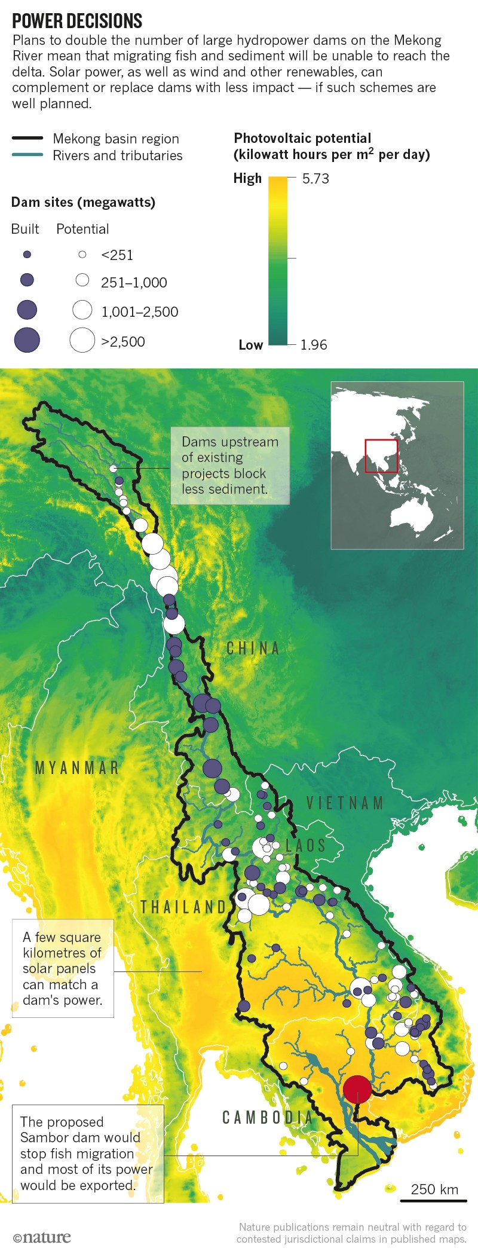
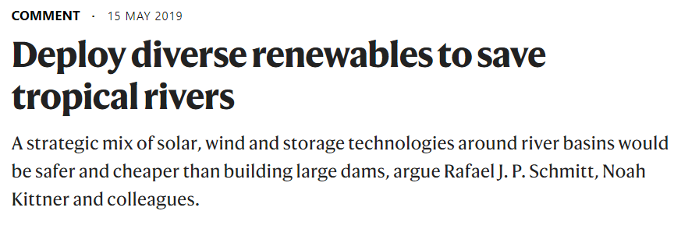
Detailed sectoral exercises may lack broader context

Slide 26
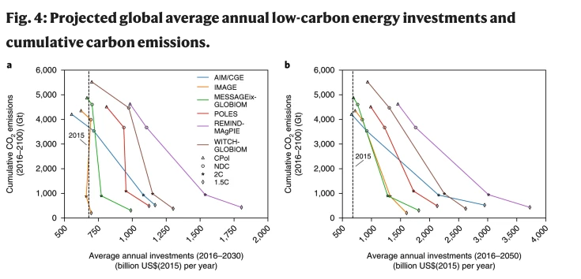
More about the dynamics, less about the numerics
What’s robust:
Inverse relationship between low-carbon energy investment and cumulative CO2
McCollum et al. 2018
Notes:
The models provide evidence of an inverse relationship between average annual low-carbon energy investments over the near and medium terms (to 2030 and 2050, respectively) and cumulative carbon emissions over the long term (to 2100; see Fig. 4): in other words, as investments in low-carbon energy and energy efficiency are progressively scaled up, cumulative CO₂ emissions can be expected to consistently decline. Though absolute investment numbers may vary to some extent, the inverse investment–emissions relationship is common across nearly all models for the two different time periods, even if the slopes vary.

Slide 27
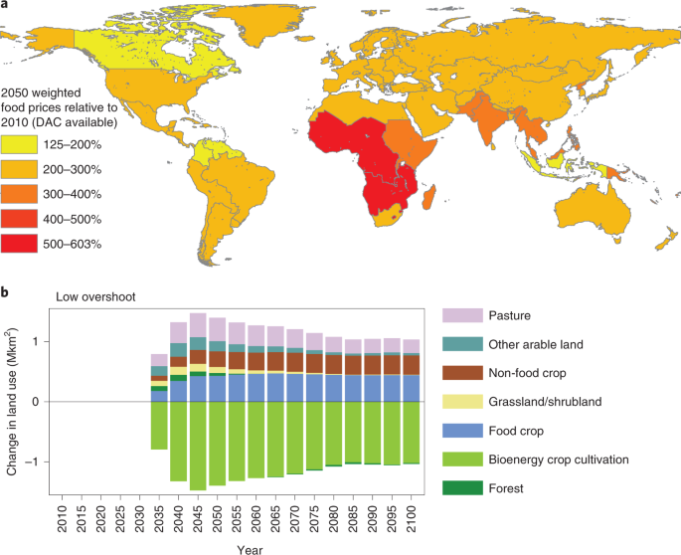
Unexpected consequences might be missed otherwise
Unexpected risks:
Increased food prices due to negative emission technologies (NETs)
Fuhrman et al. 2020. NCC
Notes:
a, Regionalized food crop prices relative to 2010 levels for the low-overshoot trajectory. b, Differential land use between DAC available and no-DAC scenarios. Combined land use devoted to BECCS and afforestation in the no-DAC scenario is over 5 Mkm² (see Fig. 1). The availability of low-cost DAC can reduce this requirement by approximately 1 Mkm² in 2050, freeing up more land for food production and ameliorating the most severe food price impacts.

Slide 28
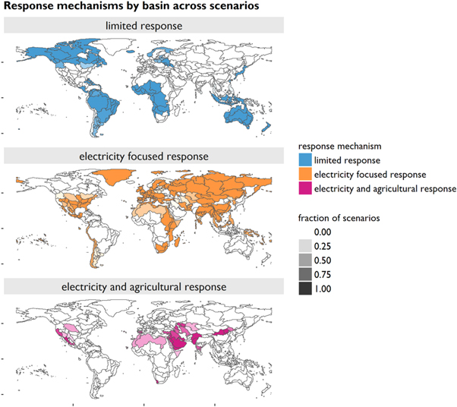
It often is not a single-sector solution to a problem
Different strategies are taken in response to water constraints, which is robust across alternative scenarios
Cui et al. 2018. ERL

Slide 29
Reference
van Vuuren, D.P., Stehfest, E., Gernaat, D.E.H.J. et al. Alternative pathways to the 1.5 °C target reduce the need for negative emission technologies. Nature Clim Change 8, 391–397 (2018). https://doi.org/10.1038/s41558-018-0119-8
Luderer, G., Vrontisi, Z., Bertram, C. et al. Residual fossil CO₂ emissions in 1.5–2 °C pathways. Nature Clim Change 8, 626–633 (2018). https://doi.org/10.1038/s41558-018-0198-6
McCollum, D.L., Zhou, W., Bertram, C. et al. Energy investment needs for fulfilling the Paris Agreement and achieving the Sustainable Development Goals. Nat Energy 3, 589–599 (2018). https://doi.org/10.1038/s41560-018-0179-z
Kim, S.H., Hejazi, M., Liu, L. et al. Balancing global water availability and use at basin scale in an integrated assessment model. Climatic Change 136, 217–231 (2016). https://doi-org.proxy-um.researchport.umd.edu/10.1007/s10584-016-1604-6
Popp et al. Land-use futures in the shared socio-economic pathways. Global Environmental Change 42, 331-345 (2017). https://doi.org/10.1016/j.gloenvcha.2016.10.002
Fuhrman, J., McJeon, H., Patel, P. et al. Food–energy–water implications of negative emissions technologies in a +1.5 °C future. Nat. Clim. Chang. 10, 920–927 (2020). https://doi.org/10.1038/s41558-020-0876-z
Cui et al. Environ. Res. Lett. 13 094006 (2018). https://doi.org/10.1088/1748-9326/aad8f7
Notes:
Haewon end

Slide 30

Break

Slide 31
Discussion questions
What’s your understanding of IAM and IAM analysis?
How are IAMs different from other modeling tools?
What do you expect to learn from this course?

Slide 32
Course objectives
Not all of you will have modeling career, but everyone in carbon neutrality field needs to have “model literacy”.
You will learn the fundamentals of integrated assessment models and research.
Understand the basic characteristics of energy, water, and land systems, their interlinkages, and the implications of those interlinkages for a range of societal goals and policies.
Learn how to frame science and policy questions that IAM is well-suited to answer.
Learn to use IAM, and interpret and communicate IAM outputs, to address science and/or policy relevant questions.
At the end of the semester, some of you will embark on future career in modeling, others will have sufficient literacy of the models to be able to interpret modeling research and utilize for your own research.

Slide 33
Approaches
Complete readings before class, get your own thoughts on the reading questions, and bring them to in-class discussion.
Learn from the lectures and ask questions.
Get hands-on IA modeling experience using the Global Change Analysis Model (GCAM).
Develop and complete an independent research project using GCAM.

Slide 34
Course schedule and topics
Date | Lecture Topic | Pre-Class Reading | What’s Due
Week 1 | Introduction to IAM | Reading 1
Week 2 | Foundations of IAM | Reading 2
Week 3 | Energy System - Supply | Reading 3a | Assignment 1
Week 4 | Energy System - Demand | Reading 3b
Week 5 | Land System | Reading 4 | Assignment 2
Week 6 | Water System | Reading 5 | Assignment 3
Week 7 | Food-Energy-Water Nexus | Reading 6 | Assignment 4
Week 8 | Mid-Term: Project Proposal |  | Project proposal
Week 9 | IAM in International Climate Policies | Reading 7
Week 10 | Standardized Scenarios | Reading 8 | Assignment 5
Week 11 | Multi-model Comparison | Reading 9
Week 12 | IAM in National Strategies | Reading 10 | Assignment 6
Week 13 | Mitigation and other SDGs | Reading 11 | Assignment 7
Week 14 | Uncertainty in IAM and Climate Change | Reading 12 | Assignment 8
Week 15 | Emerging and Future Directions | Reading 13
Week 16 | Final project presentation 1

Slide 35
Course weekly rhythm
 | Monday | Tuesday | Wednesday | Thursday | Friday
Morning |  |  | Last week's assignment due; Be prepared for discussing the readings in class | Next week’s reading posted
Afternoon |  |  | Class! This week's assignment distributed | 1:30-3 pm Office hour

Slide 36
Course evaluation
Paper Critique (20%): Each student will choose one IAM journal paper to peer-review and present the key findings and critical review of the paper.
Mid-term paper (20%): Students will develop a short proposal (3-5 pages) on the final research project for this class, including the research question and methodology.
Final project (40%): Students will work individually on a research project, apply an IA modeling tool to inform a policy question and support decision making based on results. Project will be evaluated based on in-class presentation and a written paper.
Class participation (20%): Students will participate in class discussions and attend hands-on sessions. Students will also submit modeling exercise results.

Slide 37
All assignments are designed to help you write a better term paper
Paper Critique (20%): Start your literature review. Understand the structure of an academic paper.
Mid-term paper (20%): Formulate your research.
Class participation (20%): The class modeling exercises prepare you to get equipped to do modeling runs.
Final project (40%): Learn how to write a paper and practice public presentation of your findings.

Slide 38
Assignment: Paper Critique
Read through the syllabus and pick an IAM journal paper that you would like to cite in your term paper.
Imagine you are the peer-reviewer for the paper.
Slide 1: Summarize the key findings of the paper.
Slide 2: discuss 3 strengths of the paper.
Slide 3: critique 3 weaknesses of the paper.
Slide 4: discuss how you’d improve upon it for your own research.
10 minutes at the beginning of the each class.
Earlier semester presenters will be graded more favorably.
(hint: find out which figure has the “punchline”)
NEXT WEEK: pick a paper of your choice (could be from the class readings or from the papers that cite them)

Slide 39
First modeling exercise!
The purpose of this Assignment is to help students get the Global Change Analysis Model (GCAM) installed on their computer. We will be using GCAM throughout the course to complete exercises that we will discuss during the second half of each week's lecture period. So, it's important to get GCAM installed correctly now so you can use it throughout the semester.
1. Follow the instructions on the GCAM tutorial: https://jgcri.github.io/gcam_training/gcam.html
2. Submit your screenshot with short description of your success/failure

Slide 40
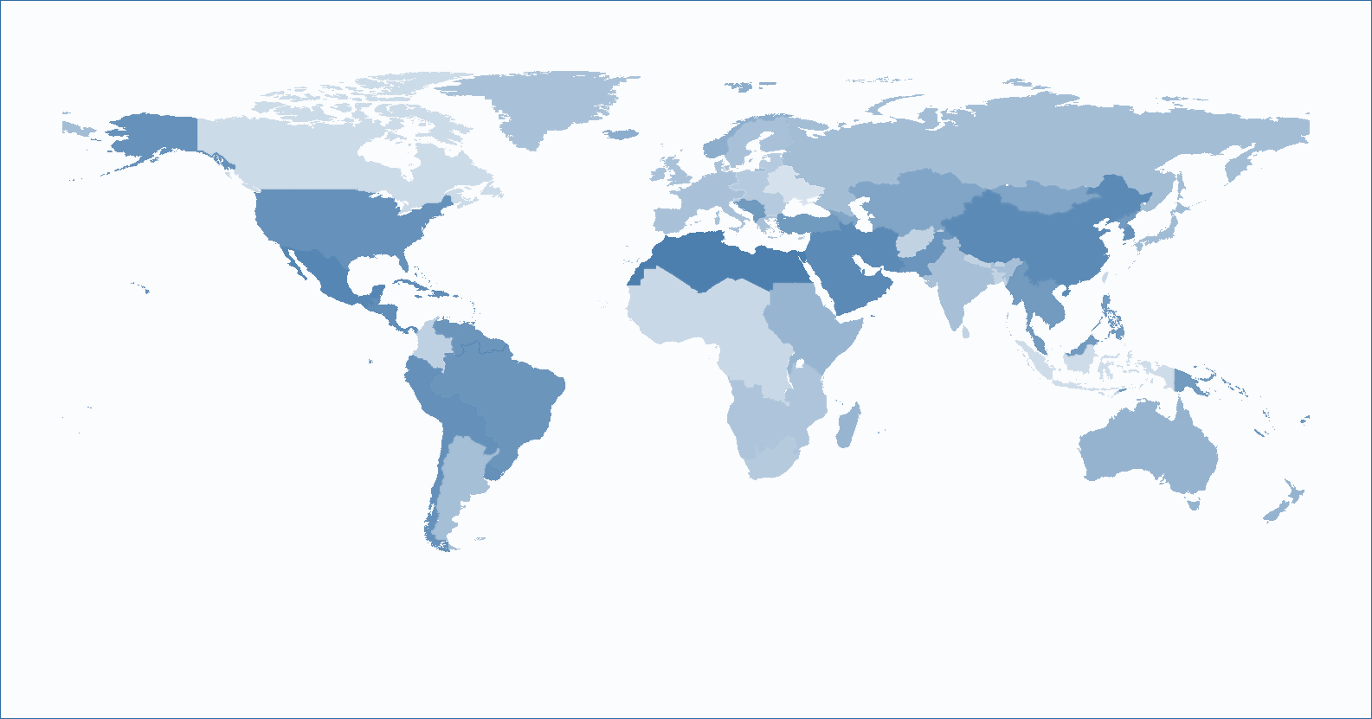
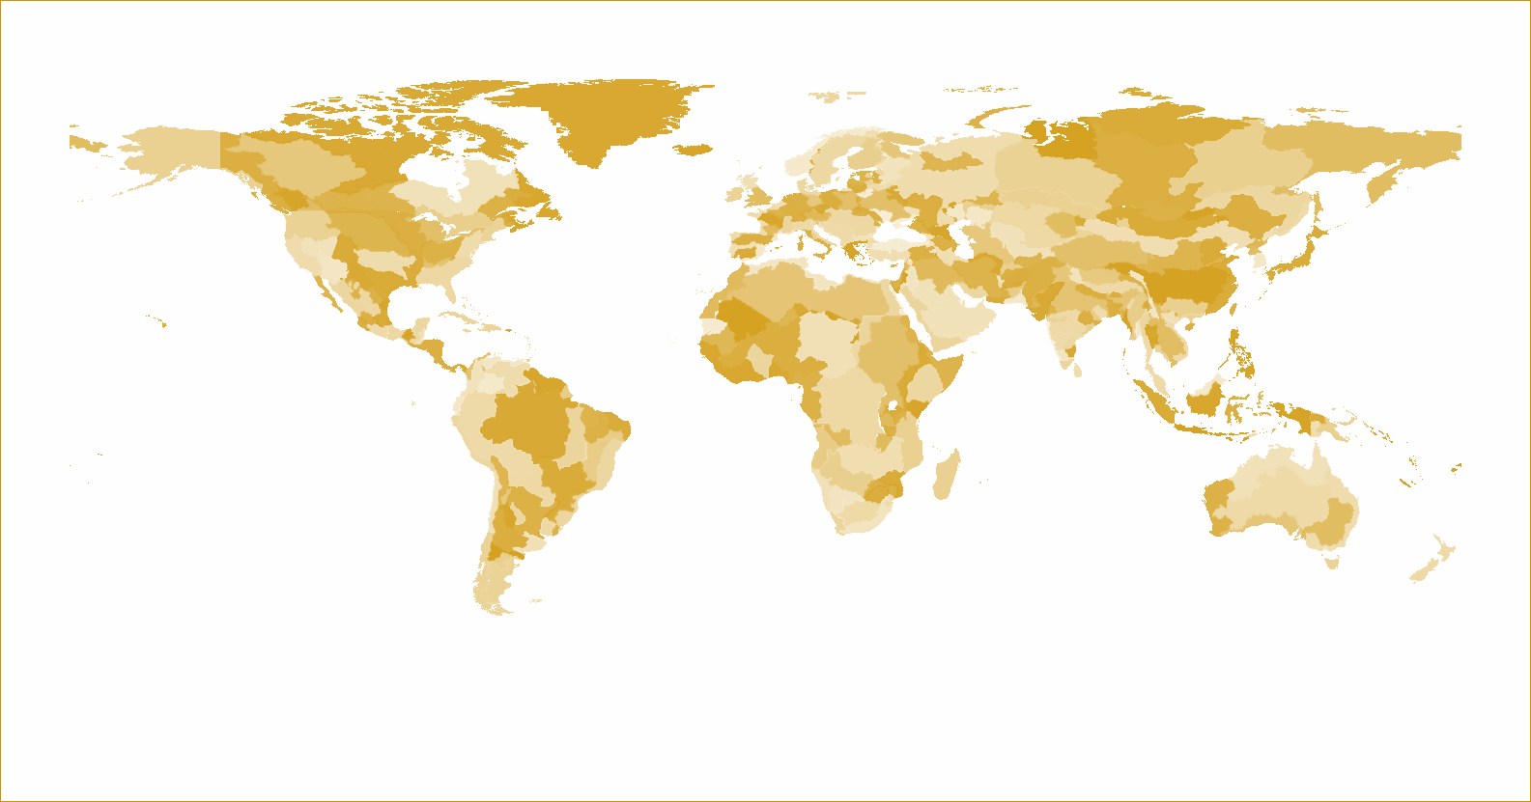
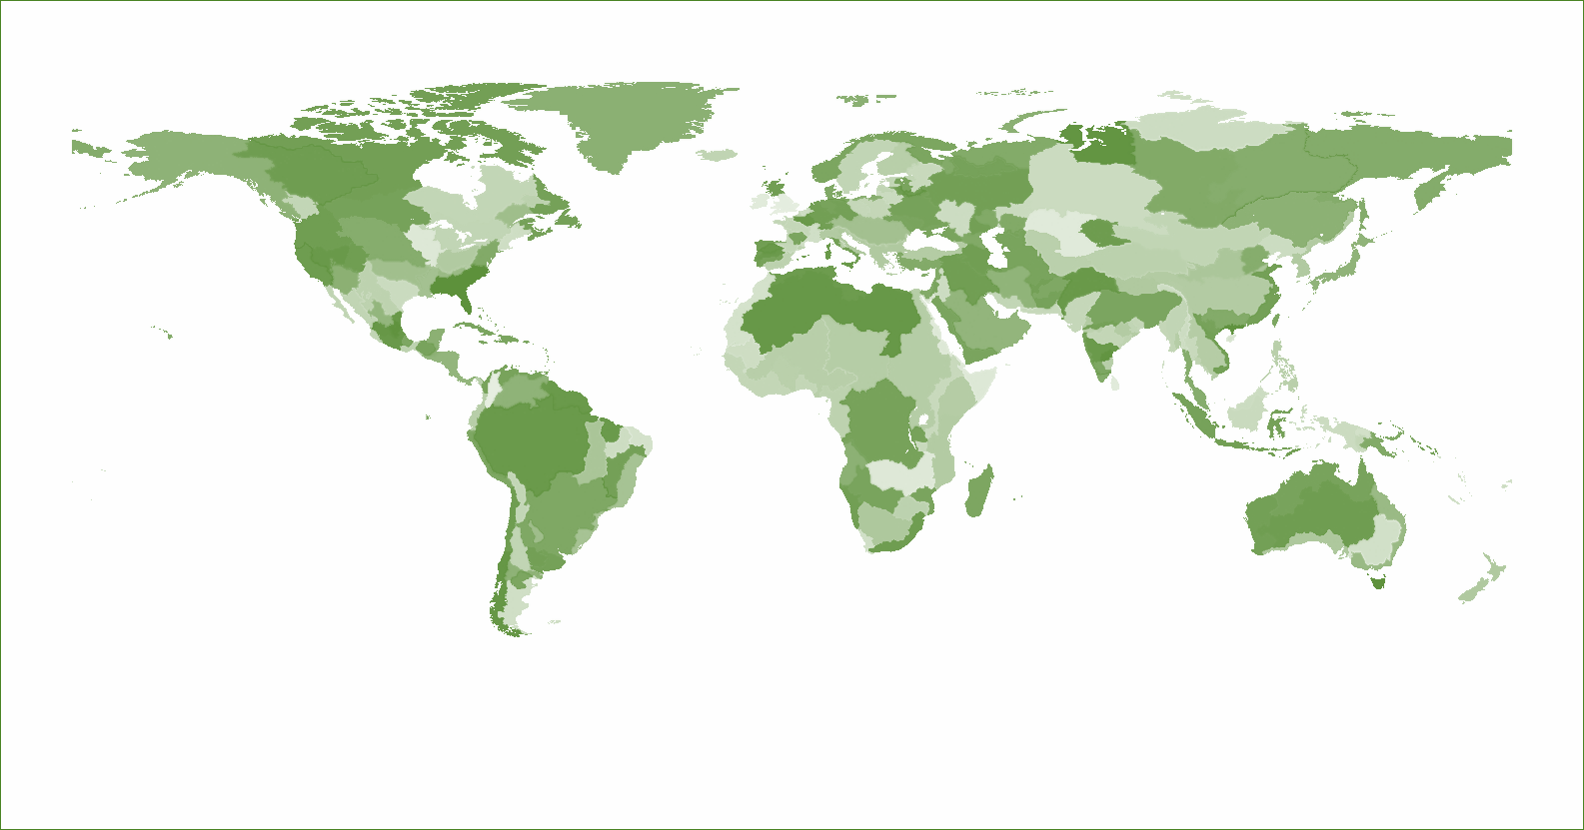
Global Change Analysis Model
Model Coverage
GCAM is a global hierarchical equilibrium integrated assessment model
GCAM links Economic, Energy, Land-use, Water, and Climate systems in a technology-rich model
Runs to 2100 in 5-year time-steps
Emissions of 16 greenhouse gases (GHG) and air pollutants are tracked
GCAM is natively coupled to a simple climate model HECTOR, but can also be coupled to Energy Exascale Earth System Model (E3SM)
GCAM is a community model, download link and documentation available at: http://jgcri.github.io/gcam-doc/toc.html
GCAM is primarily developed with support from Office of Science, but has wide reaching applications in policy, science, and philanthropies
32 Energy & Economy Regions
384 Land Regions
235 Water Basins
39

Slide 41
Downloading and Installing GCAM
Download the latest release version of gcam for windows from https://github.com/JGCRI/gcam-core/releases and unzip
Version 7.0 has the latest features (especially hydrogen, transport, and industry)
Version 6.0 is more stable
If you have older computer, you may need to use older versions (not recommended)
Recommended computer configurations:
PC: 16GB RAM, Core i5 or higher
MAC: MUST KNOW HOW TO COMPILE ON MAC
Linux/cluster/cloud/AWS: MUST KNOW HOW TO COMPILE ON LINUX
Prerequisites
No official prerequisite class, but expected to have undergrad level understandings of:
Microeconomics (do you understand marginal cost and marginal benefit?)
Climate science (do you understand greenhouse gas effect?)
Data processing (are you comfortable using complex formula in R, python, or excel?)
Computer skills (are you comfortable downloading and installing software? Bonus: can you compile C++?)
Useful guides
GCAM User Guide: http://jgcri.github.io/gcam-doc/user-guide.html
GCAM training website: https://jgcri.github.io/gcam_training/

Slide 42
Running GCAM
Pre-reqs:
Install Java JDK 64 https://developers.redhat.com/products/openjdk/download
Install R https://cran.r-project.org/ and R Studio https://www.rstudio.com
Install Windows XML Maker http://symbolclick.com/xmlmarker_1_1_setup.exe
(MAC: install XML editor of your choice. E.g. BB-edit)
Enter your MainGCAMFolder/exe/ and rename configuration_ref.xml to configuration.xml
This is in order to run the reference scenario
To run another scenario (e.g. configuration_ssp.xml or configuration_usa.xml) open run-gcam.bat in notepad and change “gcam.exe -C configuration.xml” to the new name e.g. “gcam.exe -C configuration_usa.xml” ( on line 25).
Enter your MainGCAMFolder/exe/ and run run-gcam.bat
Outputs will be written to MainGCAMFolder/output/database_basexdb
Can visualize data from MainGCAMFolder/ModelInterface/run-model-interface.bat (see Section on Viewing Results)

Slide 43
Q&A

Slide 44
Course schedule and topics
Date | Lecture Topic | Pre-Class Reading | What’s Due
8/30 | Introduction to IAM | Reading 1
9/6 | Foundations of IAM | Reading 2
9/13 | Energy System - Supply | Reading 3a | Assignment 1
9/20 | Energy System - Demand | Reading 3b
9/27 CJU | Land System | Reading 4 | Assignment 2
10/4 | Water System | Reading 5 | Assignment 3
10/11 | Food-Energy-Water Nexus | Reading 6 | Assignment 4
10/18 | Mid-Term: Project Proposal |  | Project proposal
10/25 | IAM in International Climate Policies | Reading 7
11/1 | Standardized Scenarios | Reading 8 | Assignment 5
11/8 | Multi-model Comparison | Reading 9
11/15 IAMC | IAM in National Strategies | Reading 10 | Assignment 6
11/22 | Mitigation and other SDGs | Reading 11 | Assignment 7
11/29 | Uncertainty in IAM and Climate Change | Reading 12 | Assignment 8
12/6 | Emerging and Future Directions | Reading 13
12/13 | Final project presentation 1

